Slide 1
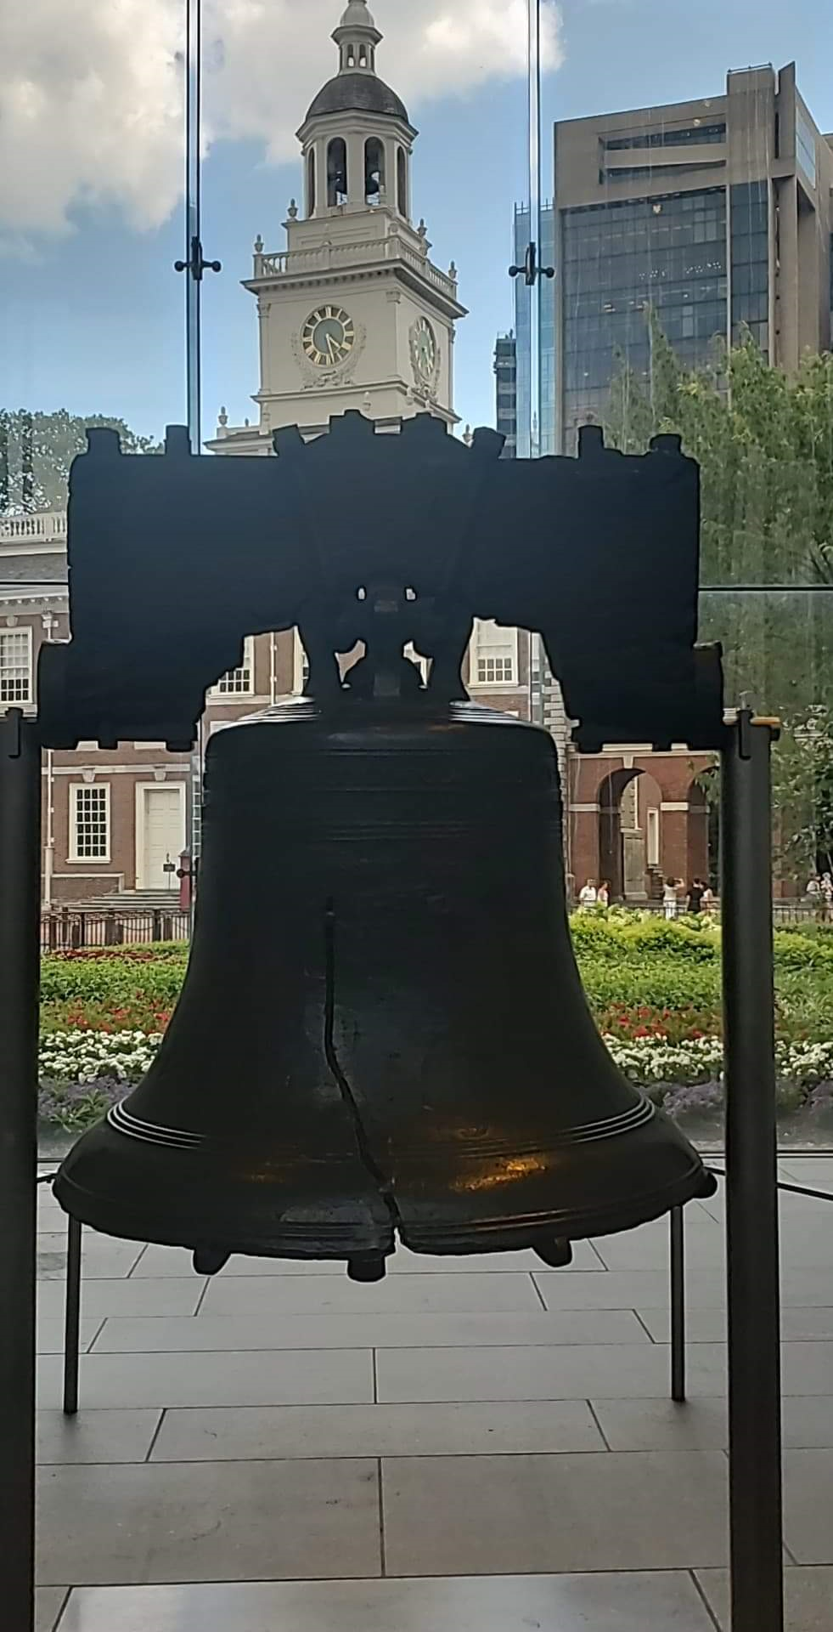
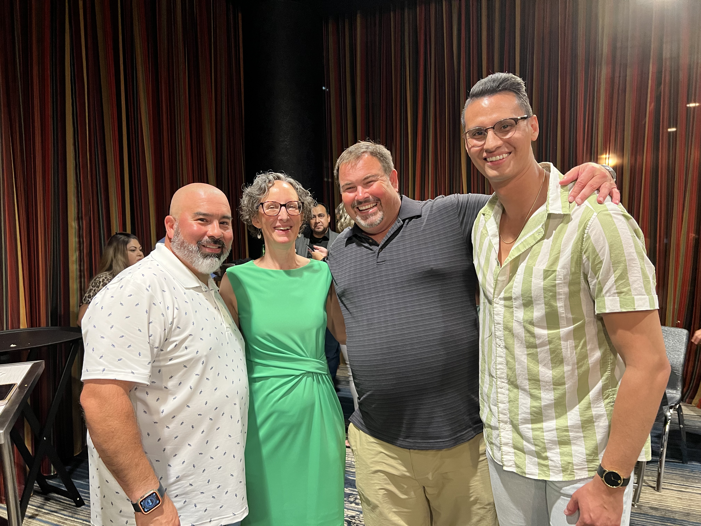
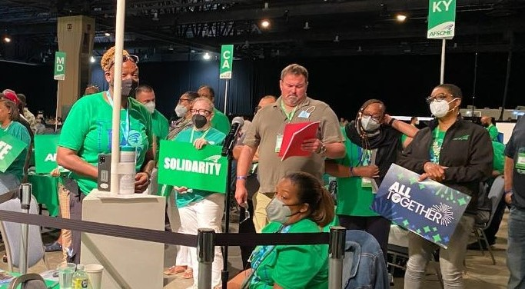

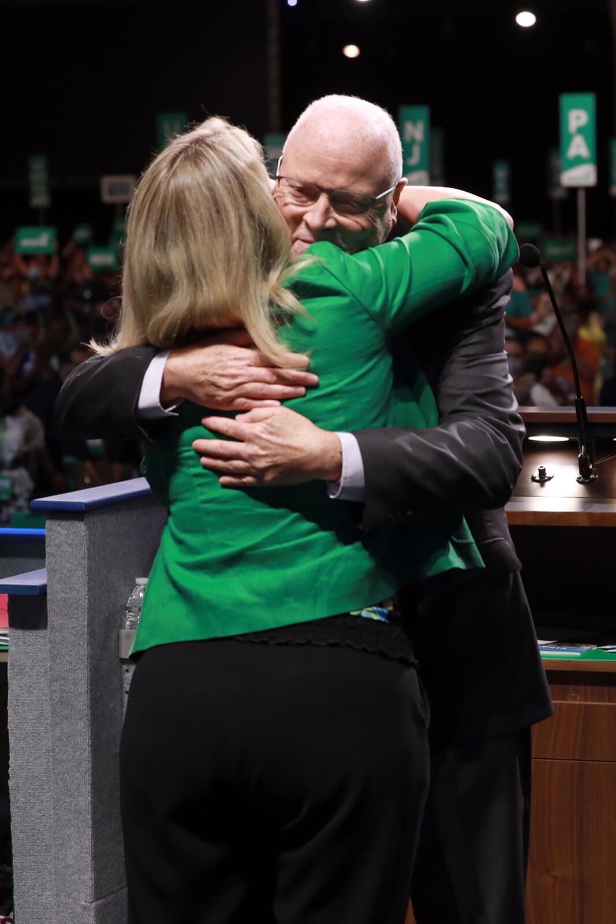
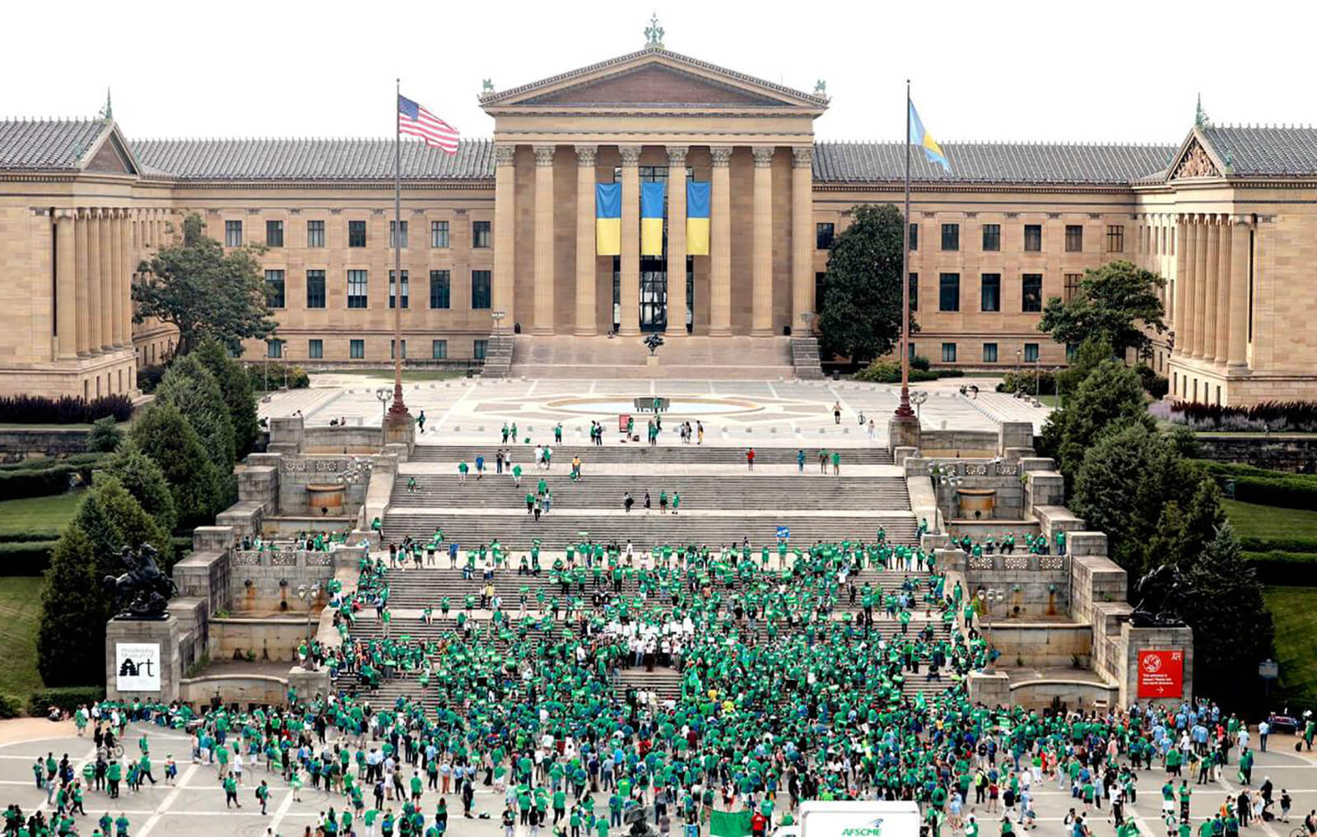


Slide 2
AFSCME 45TH INTERNATIONAL CONVENTION MEMBER RECAP
Convention resolutions
Electing afscme officers
Rally in solidarity

Slide 3

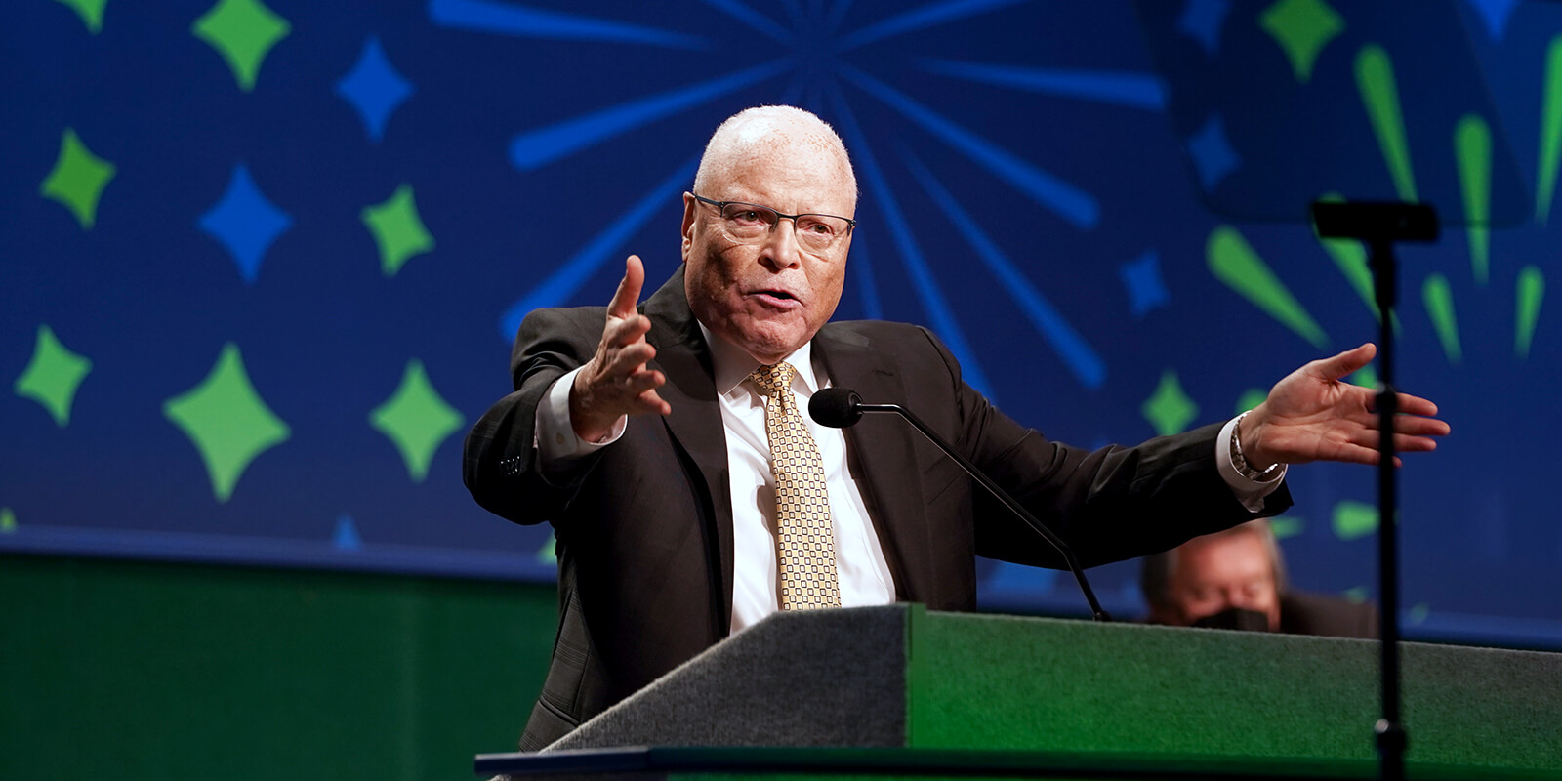
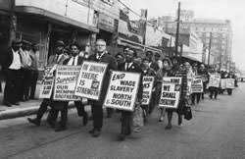
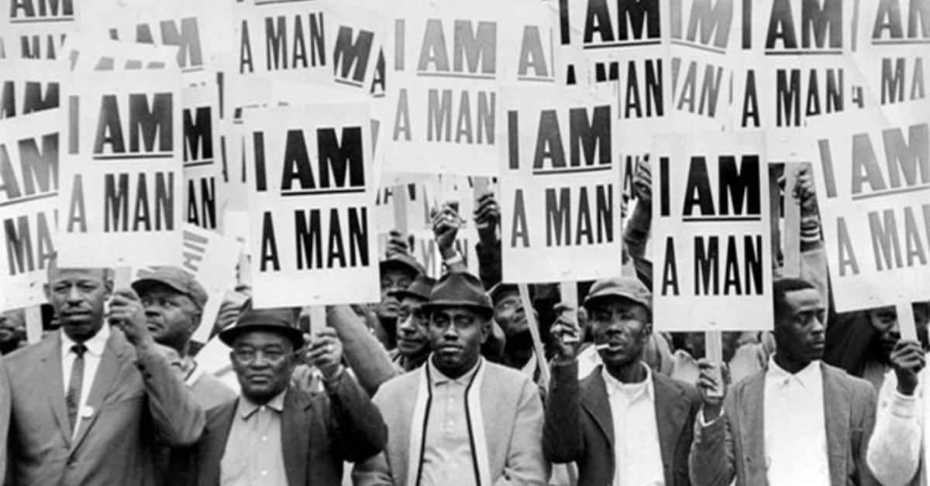
RESOLUTIONS
DELEGATES DEBATED AND VOTED ON ISSUES OF VITAL IMPTORTANCE TO OUR COMMUNITY, WORKPLACE, AND UNION. THROUGH OPEN DISCUSSION OF ISSUES DELEGATES HELP SET OUR UNION’S PRIORITIES FOR THE FUTURE, RENEW SHARED COMMITMENTS AND STRATEGIZE TO MAKE US STRONGER.

Slide 4

37 RESOLUTIONS DEBATED AND APPROVED
EXPANDING PUBLIC SECTOR APPRENTICESHIPS(#1)
USE AMERICAN RESCUE PLAN FUNDS TO STRENGTHEN THE PUBLIC SECTOR WORKFORCE (#2)
STUDENT DEBT RELIEF (#5)
LONG TERM FEDERAL INVESTMENTS IN PUBLIC SERVICES (#11)
FIGHTING AND EXPANDING SUPPORT FOR FULL REPEAL OF THE SOCIAL SECURITY WINDFALL ELIMINATION PROVISION AND GOVERNMENT PENSION OFFSET (#7)
TRANS AUTONOMY (#22)
VOTING RIGHTS: MAKING GOOD TROUBLE (#32)
ADDRESSING INFLATION TO CREATE A FAIR ECONOMY (#35)
DEFENDING REPRODUCTIVE RIGHTS (#36)
COMMITTING OUR UNION TO RACIAL AND GENDER EQUITY (COURAGE) (#33)
This Photo by Unknown Author is licensed under CC BY-NC

Slide 5
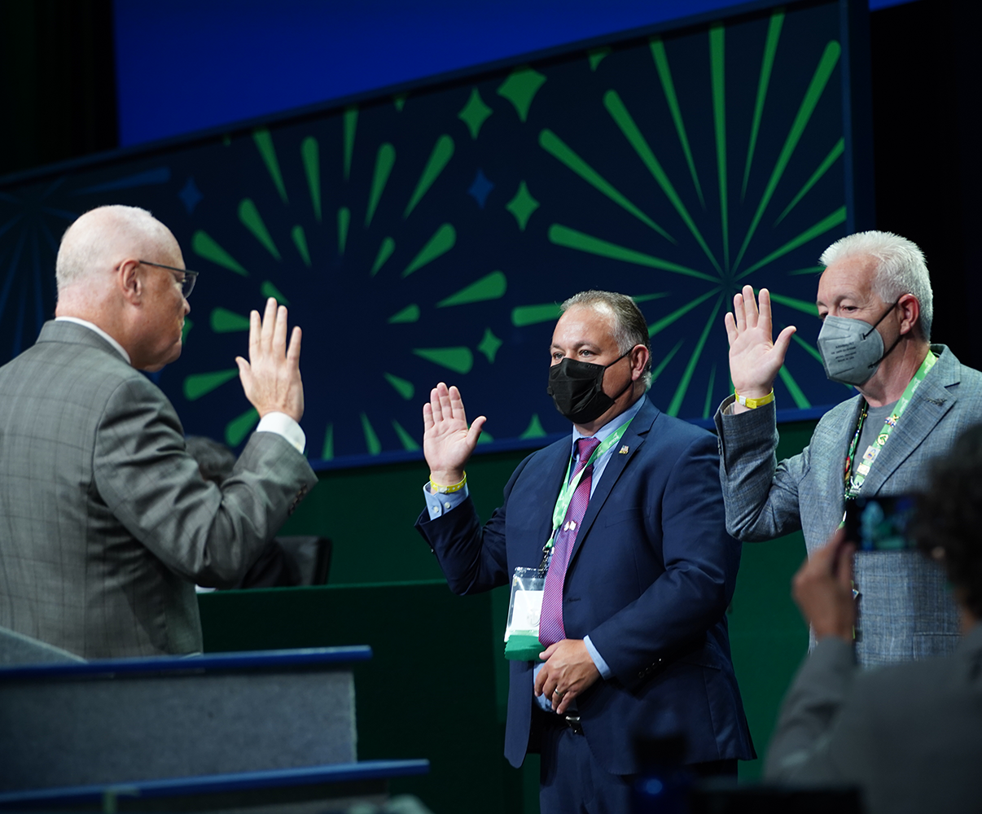

ELECTING OFFICERS
RICK EILANDER, PRSIDENT OF COUNCIL (61) AND TOM TOSTI, DIRECTOR OF PA DISTRICT COUNCIL 88 WERE SWORN IN AS NEW INTERNATIONAL VICE PRESIDENTS

Slide 6
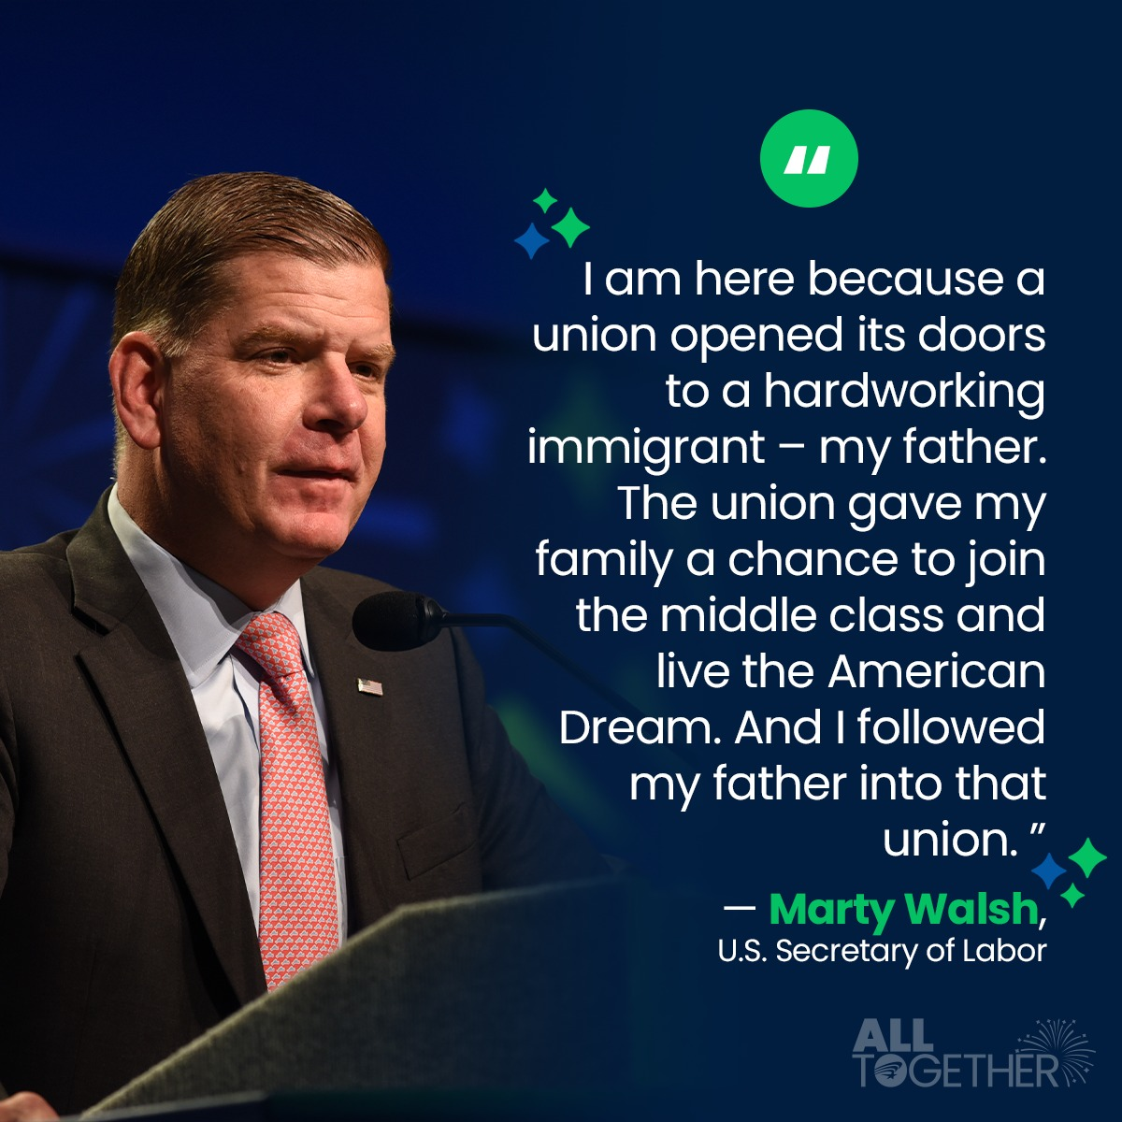
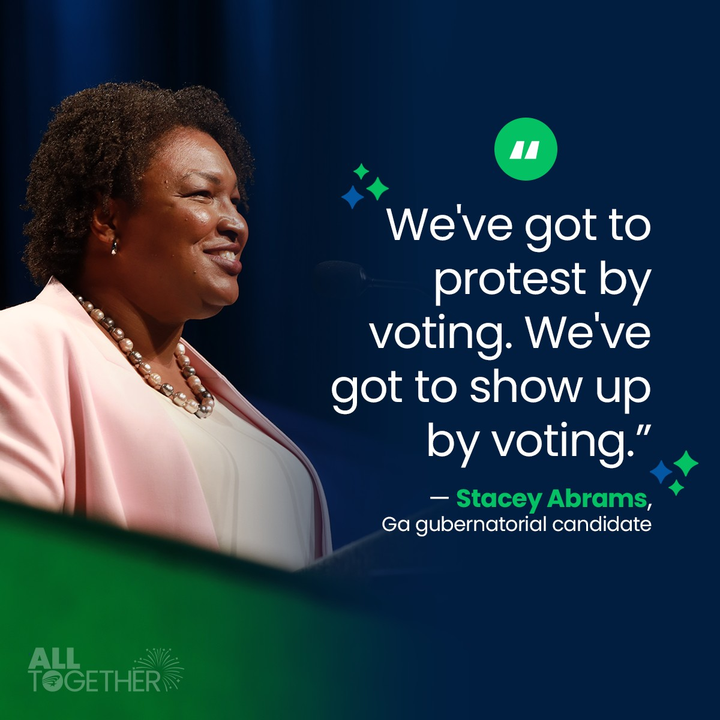
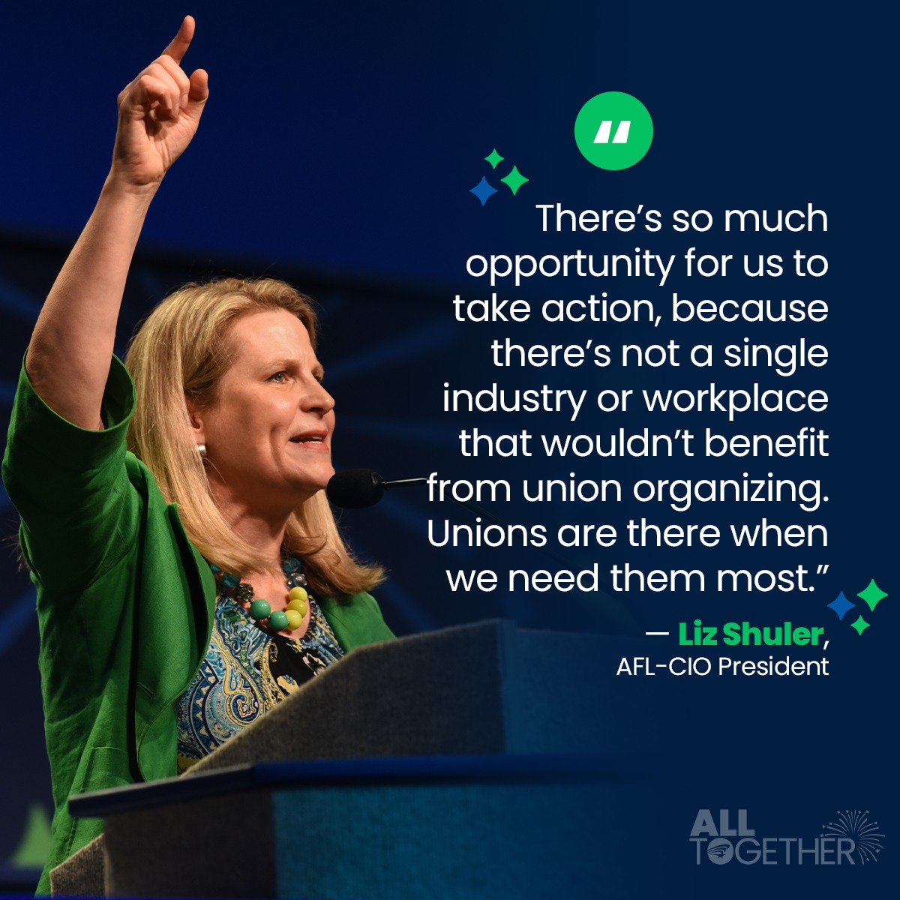

SOME KEYNOTE SPEAKERS
LET’S GET FIRED UP!! MOTIVATION TO BUILD POWER THROUGH POLITICAL ACTION
“VOTING IS NOT MAGIC. VOTING IS MEDICINE. VOTING IS HOW WE TREAT THE ILLS OF SOCIETY.” –STACEY ABRAMS

Slide 7

PHILADELPHIA MUSEUM OF ART
IN SOLIDARITY ATTENDEES AT AFSCME 45TH INTERNATIONAL CONVENTION RALLIED IN SUPPORT OF FELLOW MEMBERS WHO HAVE BEEN STONEWALLED BY MUSEUM MANAGEMENT FOR NEARLY 2 YEARS AT THE STEPS OF PMA

Slide 8
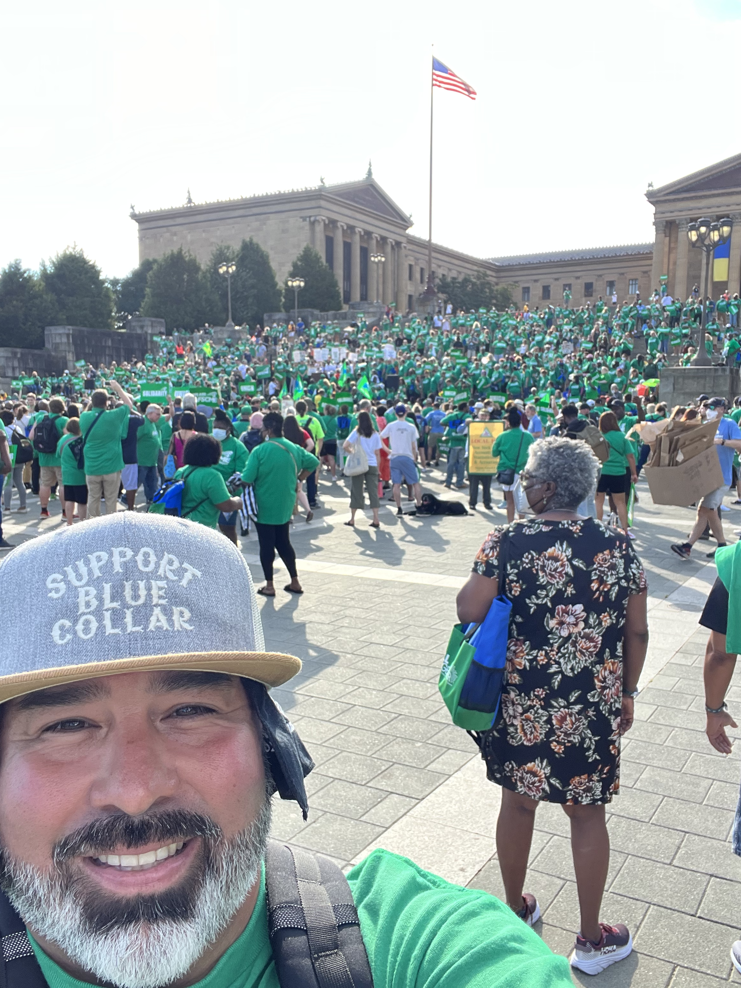
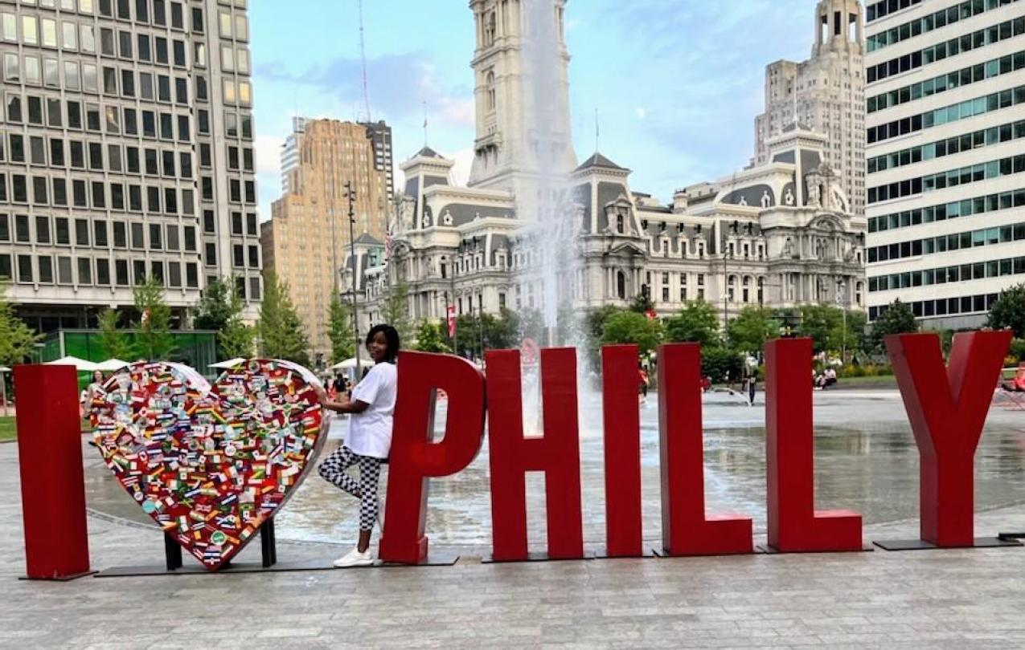
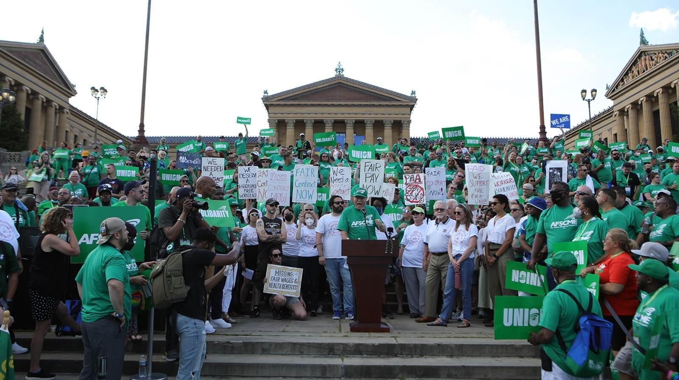
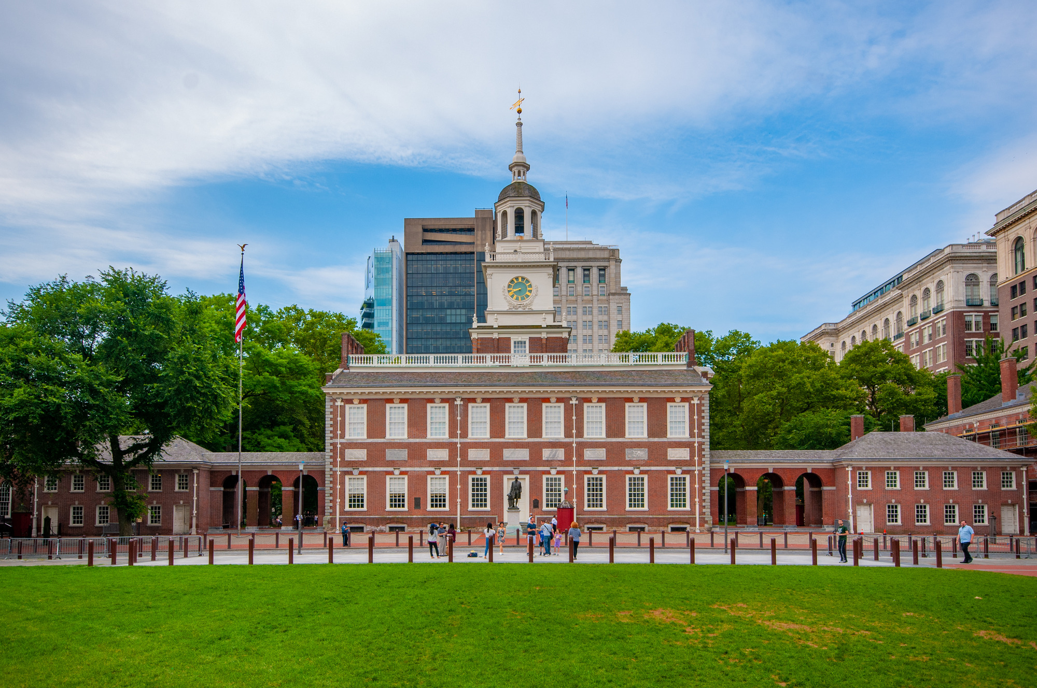
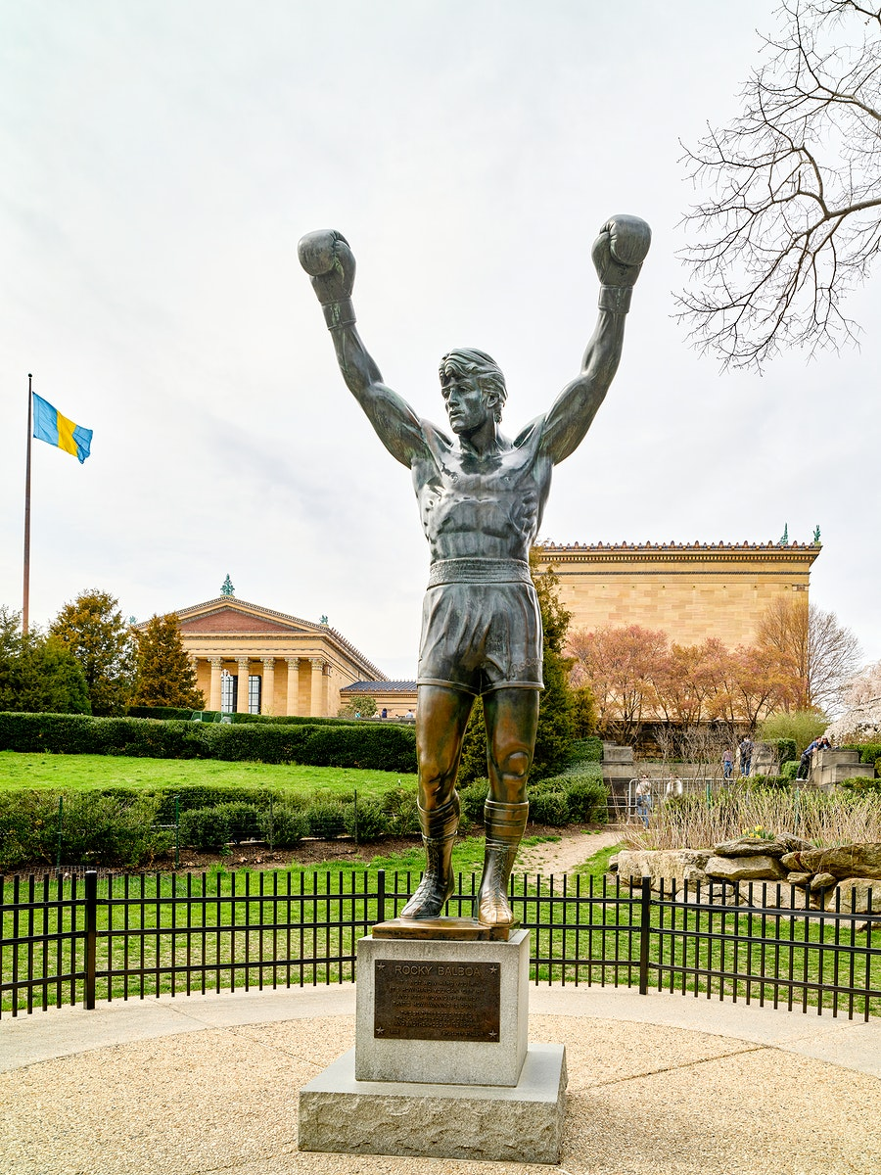
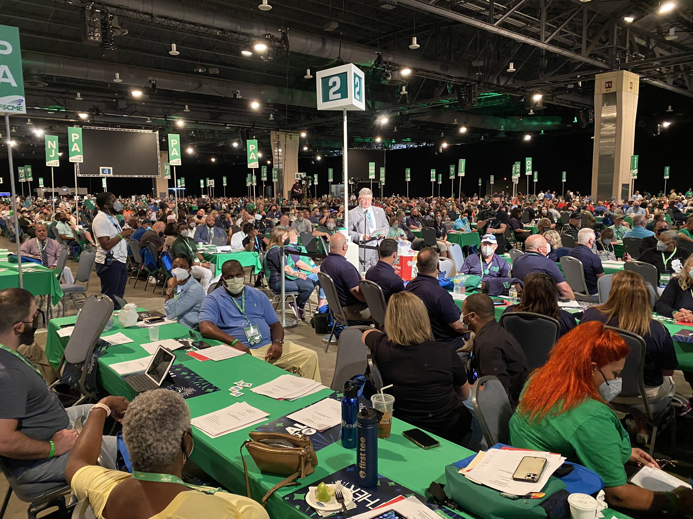
Thank You Philly!

